Slide 1
Il packaging attivo nel mercato dell’ortofrutta:
il caso SAES Coated Films
Stefano Tominetti, Ph.D
Managing Director
Pavia - May 17, 2018

Slide 2
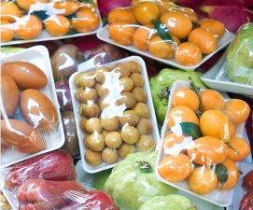


About our Group: SAES Group
Italian Public Company
250 Mio € Net Sales
11 Manufacturing facilities worldwide
1100 Employees
Functional materials and gas management in high tech markets and flexible packaging
Since April 12, 2018

Slide 3
Our contribution to Sustainable Packaging
ECO-FRIENDLY
COMPOSTABLE
ACTIVE
CO₂ REDUCTION
down gauging
PLASTIC-FREE
LESS FOOD WASTE
CO₂ REDUCTION
No Al foil
100% RECYCLABLE
Mono-materials

Slide 4
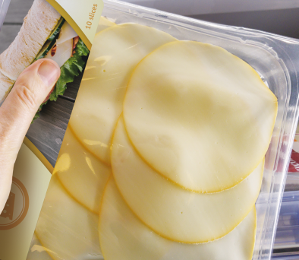

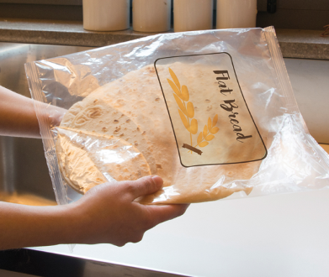
Our contribution to Sustainable Packaging
ECO-FRIENDLY
CO₂ REDUCTION
down gauging
CO₂ REDUCTION
No Al foil
100% RECYCLABLE
Mono-materials

Slide 5
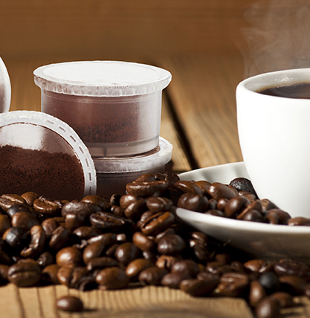
Our contribution to Sustainable Packaging
COMPOSTABLE
PLASTIC-FREE

Slide 6
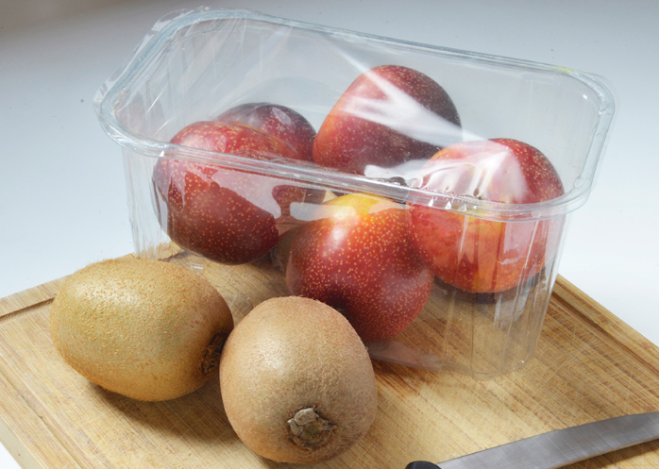

Our contribution to Sustainable Packaging
ACTIVE
LESS FOOD WASTE

Slide 7
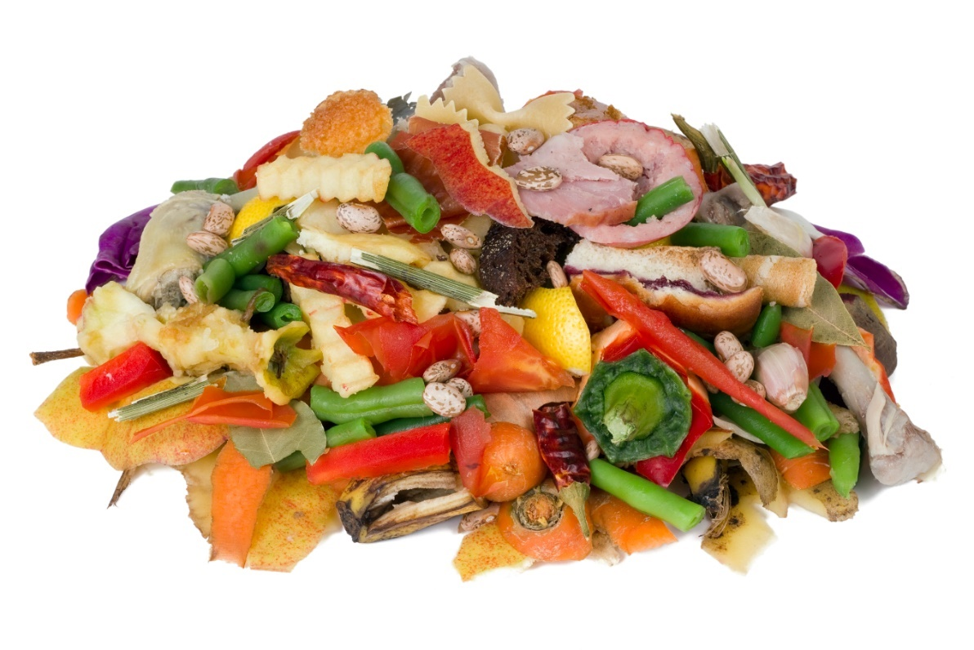

Environmental and Food sustainability
The resources used to produce food that is eventually lost or wasted account for approximately 4.4 gigatonnes of greenhouse gas emissions (CO₂ equivalent) annually, making food loss and waste the world’s third largest emitter, after only China and the United States.
The resources used to produce food that is eventually lost or wasted account for approximately 4.4 gigatonnes of greenhouse gas emissions (CO₂ equivalent) annually, making food loss and waste the world’s third largest emitter, after only China and the United States.
http://www.fao.org/save-food

Slide 8
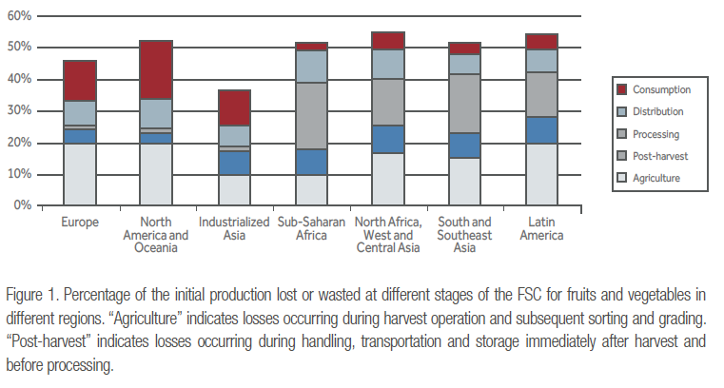
Fruit and vegetable waste in developed economies
Waste in all Fruit & Veg. supply chain is also substantial in the first three regions,
with 15-30% of purchases by mass discarded by consumers.
http://www.fao.org/save-food

Slide 9



How to take care of the produces?
Ethylene is one the key factors influencing fruit & vegetable degradation
C₂H₄
C₂H₄
C₂H₄
C₂H₄
*Ethylene production from different fresh produce types
Low (<1,0 μl kg⁻¹ h⁻¹) | Moderate (1-10 μl kg⁻¹ h⁻¹) | High (1-100 μl kg⁻¹ h⁻¹) | Very high ( >100 μl kg⁻¹ h⁻¹)
Orange, Blueberry, Plum | Banana, Mango, Tomato | Apricot, Pear, Kiwi | Apple, Avocado
*Platinum Metals Rev. 2009, 53, (3)

Slide 10



Multivariable mechanism: Ethylene sensitive products
SAES Ethylene-free film absorbs Ethylene through its engineered zeolites controlling the atmosphere into typical package
PRODUCT CULTIVARS
C₂H₄
C₂H₄
C₂H₄
C₂H₄
STORAGE TEMPERATURE
ETHYLENE EMISSION
QUANTITY
SAES in partnership with its clients can address the best cases

Slide 11
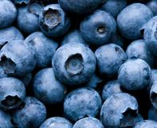
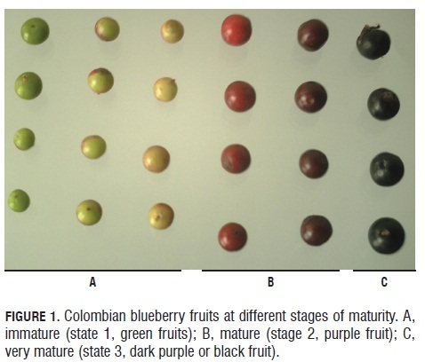
Case study: Blueberry
Commercial species
Highbush blueberry - 3 varieties ( early= end may-end July; medium=end June-end July; late= end July-end sept.) – 24 cultivar
Lowbush blueberry
Rabbiteye blueberry – 3 varieties – 4 cultivar
Ethylene production rate and sensitivity
Reference at 20°C: 0.1-1 μl kg⁻¹ h⁻¹ (non climacteric)
Ethylene peak arises in synchrony with green-pink stage: 0.1 μl kg⁻¹ h⁻¹ C₂H₄ vs. 15-50 mg kg⁻¹ h⁻¹ CO₂ (Lipe, 1978, - Windus et al., 1976) (not at last stage of ripening, i.e. at the beginning of senescense)
Forney (2003), states that blocking ethylene action with 1-MCP, had no effect on the post-harvest quality or storage life of blueberries.
Rabbiteye blueberry cultivars differ considerably in terms of their respiration rate, ethylene production and moisture loss. “Premier” shows non detectable level of ethylene (at 20°C ?), “Climax” produced 4-6.5 μl kg⁻¹ h⁻¹ , while “Brightwell” were in the range of 0.012-0.047 μl kg⁻¹ h⁻¹

Slide 12
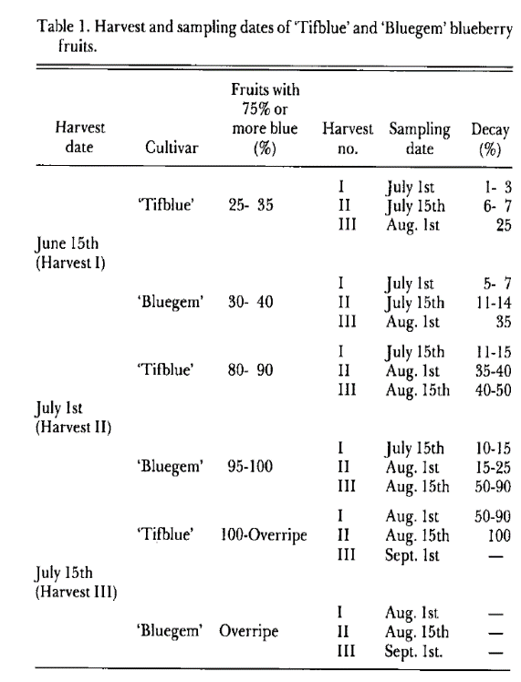
Case study: Blueberry
Respiration rate
Reference at 5°C = 10-20 ml kg⁻¹ h⁻¹ CO₂ (moderate respiration rate)
Once berries are picked, they maintain their living status and consume reserve of organic materials, with a rapid decline in quality
Blueberries have a Q10 of 3 (respiration increases 3 time each 10°C)
Decay
Diseases is the main cause of blueberries decay, associated with Botrytis cinerea infection. It has been documented that the attack of the fruit by microorganism causes significant increases in ethylene evolution (Burg, 1962). Ethylene stimulate production of H2O2 which produces fast necrosis of tissue attached by grey mould, avoiding further proliferation
Decay incidence is higher if harvest occurs during cool, rainy weather
Blueberries show a moisture loss of 1%w/w per week, while in closed plastic container it reduces down to 0.3% w/w per week. Moisture loss is associated with increased ethylene and CO₂ production
Decay is concentrated in fruit with low acidity and high TSS.
Market tolerance for decay is set at 2% at the end of the shelf life period, therefore decay must be reduced almost to zero

Slide 13
Case study: Blueberry
Storage conditions
The optimum conditions are 90-95% R.H. and 2°C
There are two main supermarket scenario: 22-24°C or 2°C in refrigerated displays (which run closer to 6-7°C).
Storage < 2-3 weeks (extremely variable).
MAP
T 1-2°C, R.H. 95%, 10-15% CO₂ and O₂ levels no lower than 3-4% (Ehlenfeldt,2002).
Possible disadvantages associated are: 1) development of off flavours and fermented taste due to shifting to fermentative metabolism (CO₂ > 15%) ; 2) after removal of fruits (or opening the package) from MAP, the deteriorates faster than freshly marked berries (Ehlenfeldt,2002).
For imported blueberries = possible synergy with ethylene scavenger (value chain import/export)

Slide 14
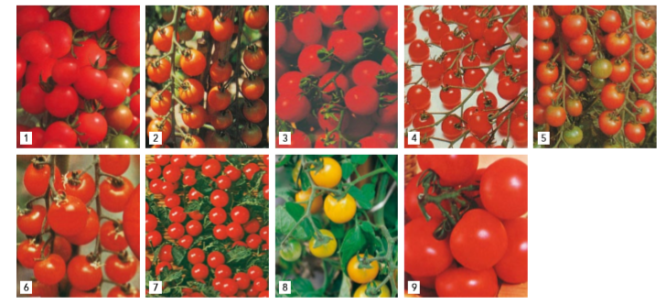
Case study: Cherry Tomato
Cultivars
Main commercial cultivars: 9 (Ciliegia, Ciliegia F1, Suncherry, Pepe, Chipano, Small fry, Lilliput, Golden nugget, Tondino)
Ethylene production rate and sensitivity
Ethylene triggers the ripening process of tomato affecting the storage durability and shelf life (loss of quality) and inducing fruit decay.
5°C = 0.5 μl kg⁻¹ h⁻¹
7.5°C = 0.7 μl kg⁻¹ h⁻¹
10°C = 1.3 μl kg⁻¹ h⁻¹ (Optimal storage condition)
12°C = 2 μl kg⁻¹ h⁻¹
After transfer at 20°C (post cold storage) = max 6 μl kg⁻¹ h⁻¹ after 21 days
The addition of GAC-Pd led to the lower ethylene accumulation inside packages, while the higher was obtained in controls. The parameters related to ripening showed that treated tomatoes exhibited a reduction in color evolution, softening, and weight loss, especially for GAC-Pd treatment. Moreover, these treatments were also effective in delaying tomato decay. After sensorial panel, tomatoes treated with GAC-Pd received the higher scores in terms of sweetness, firmness, juiciness, color, odor, and flavor (Bailen et al., 2006).

Slide 15
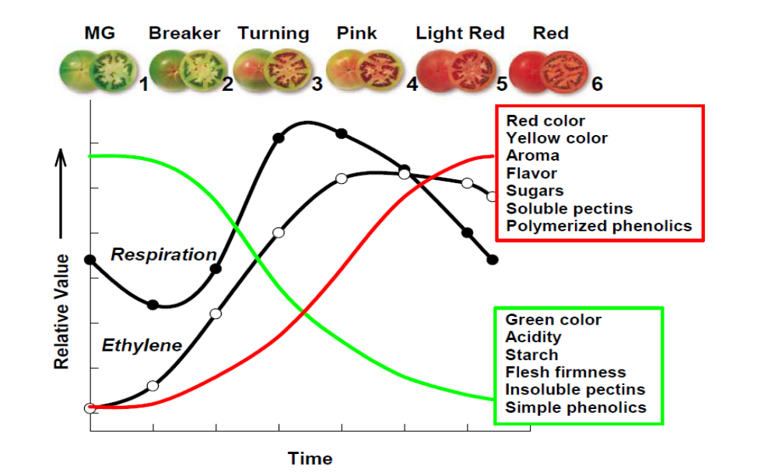
Case study: Cherry Tomato
Respiration Rate (CO₂ emitted)
5°C = 2.5 ml kg⁻¹ h⁻¹
7.5°C = 4 ml kg⁻¹ h⁻¹
10°C = 6 ml kg⁻¹ h⁻¹ (Optimal storage condition)
12°C = 8 ml kg⁻¹ h⁻¹
After transfer at 20°C (post cold storage) = max 23 ml kg⁻¹ h⁻¹

Slide 16
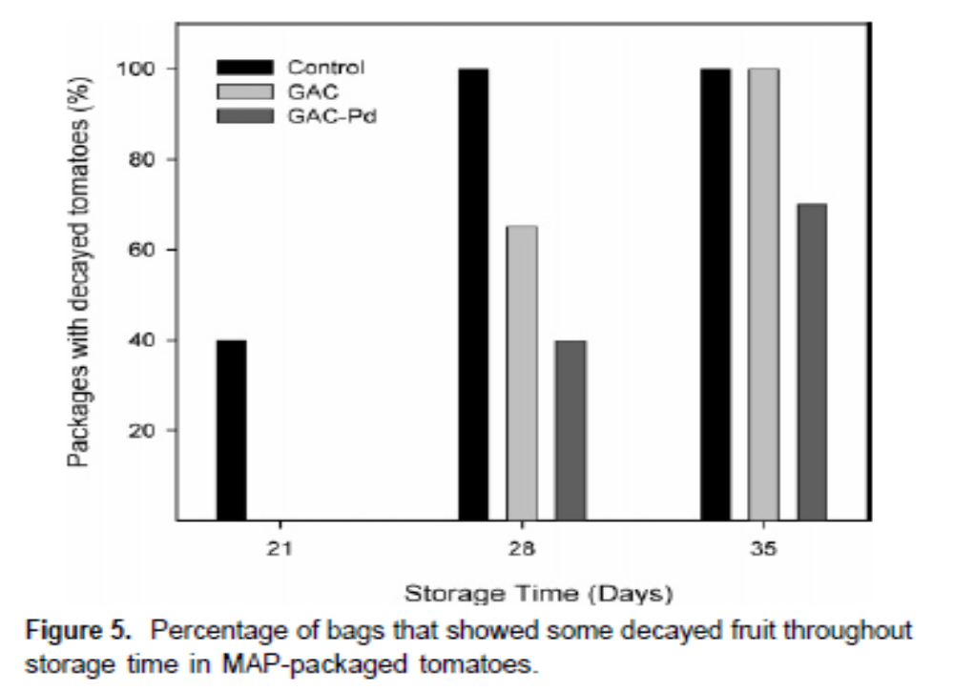
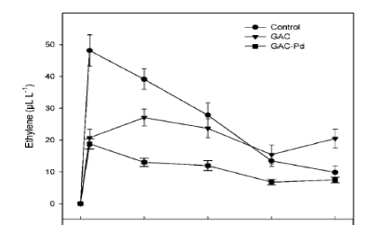
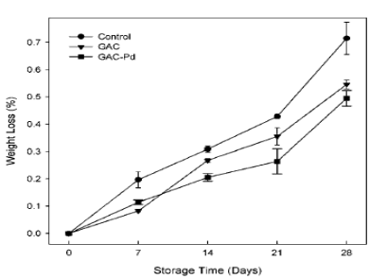
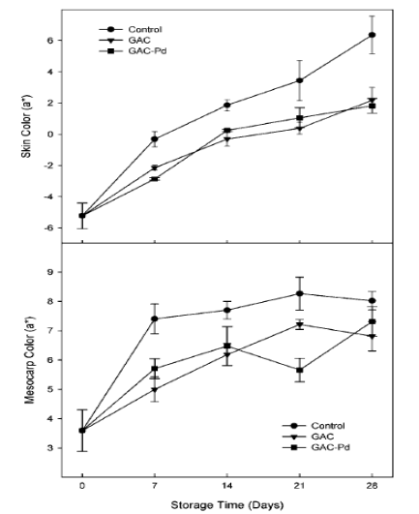
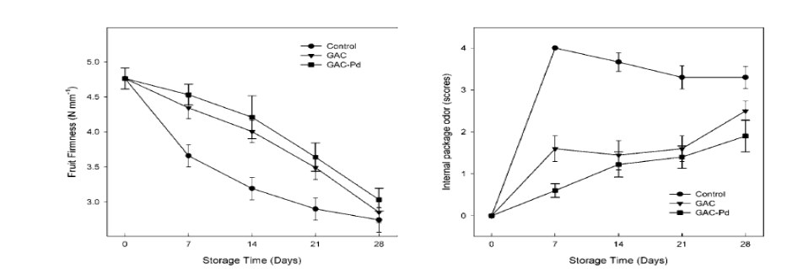
Case study: Cherry Tomato
Decay
Mold/bacterial growth
Color
Firmness
Weight loss
Sensorial (associated to fermentation in MAP)

Slide 17

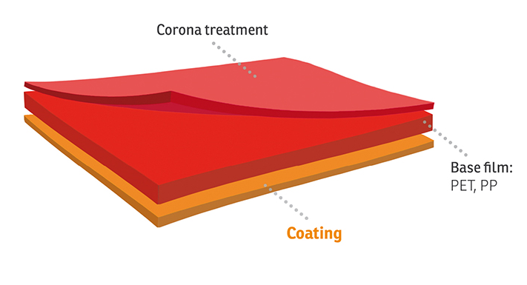
Packaging features
Water based coating
Fully integrated
Mono material
Mono layer
Fully transparent
High gas selectivity

Slide 18
The main benefits for the fruit & veg.
Better organoleptic taste
Longer shelf life
Better hygienic conditions
Better nutritional stability all over shelf life
Maintain the texture and freshness
Maintain the fresh appearance

Slide 19


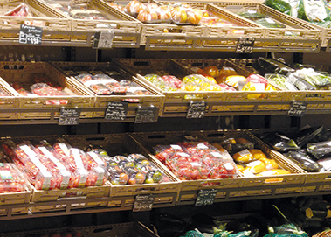

The beginning of a virtuous circle
HIGHER
FREQUENCY
OF PURCHASE
MORE
PENETRATION
REDUCED
FOOD
WASTE

Slide 20

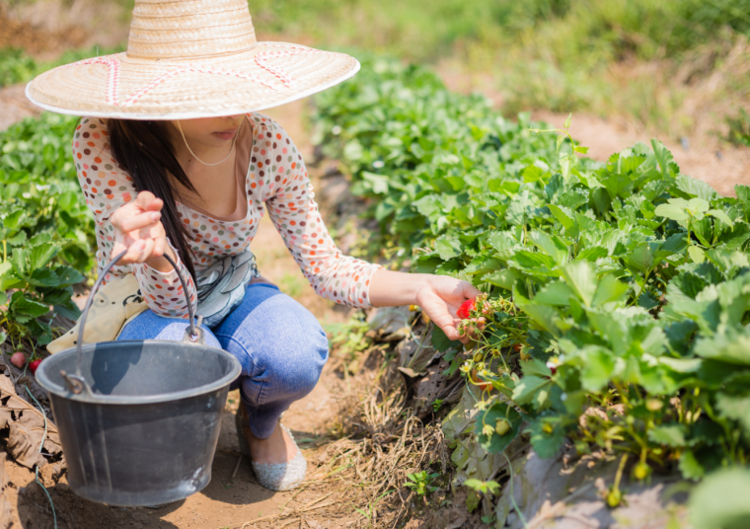
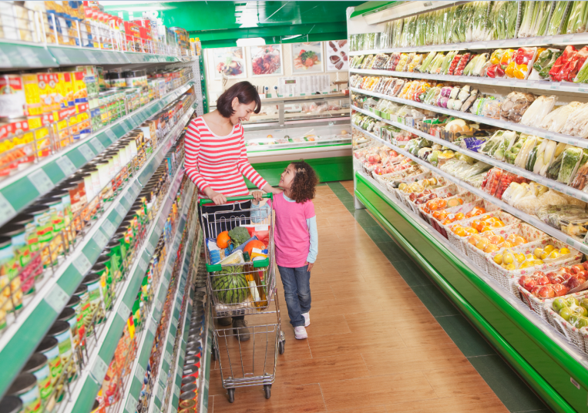

Benefits along value chain: from farm to fork
Farmer & Packer
Point of Sale
Home
Food waste is up to packaging, packaging is up to us… let’s implement it together

